Slide 1
New Opportunities for Criminal Growth
Forecasting Cyber-Crime during the IPv6 Transition
Barry Raveendran Greene
bgreene@isc.org
Version 1.1

Slide 2
Context
The Internet Systems Consortium (ISC) is a strong driver for IPv6 adoption.
The information contained in this presentation is an effort to empower organizations to deploy IPv6 to take extra effort to be mindful of their security risk.
Risk can be mitigated if a clear understanding of the risk exist.
It takes one big “IPv6 back doors a network” Press Cycle to shake the confidence of CIOs around the World – slowing down IPv6 deployment.

Slide 3
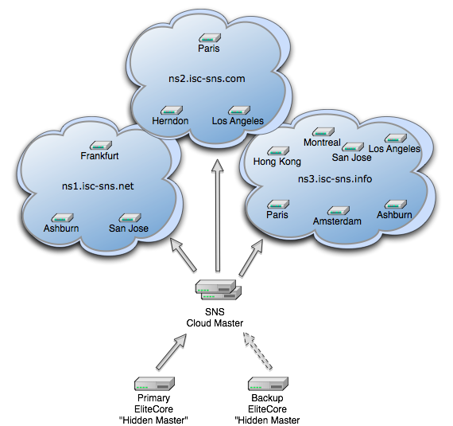
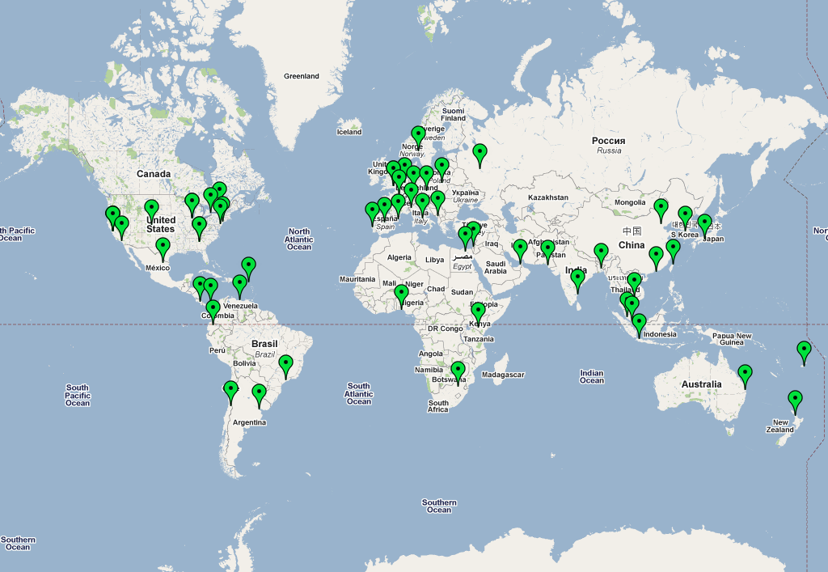
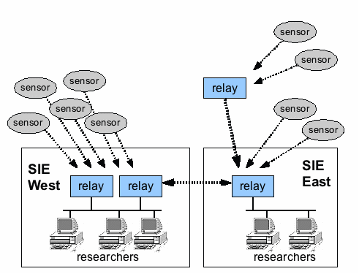



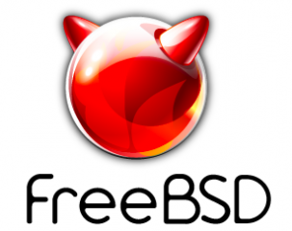
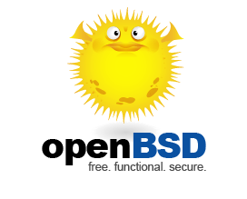
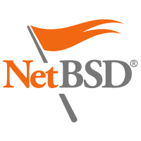












ISC and IPv6
Yes! IPv6 is running natively at my desk, on our wireless, our services, our software, our services, and VPN tunneled from home.
Open Source Software that are the “Gears” of the Net
BIND DHCP
AFTR PCP
RPKI (TBA)
Secondary DNS Services
DNS F-Root
SIE
pDNS
Hosted @ w/ Open Source Community and Others
Internet Systems Consortium, Inc. (ISC) is a non-profit 501(c)(3) public benefit corporation dedicated to supporting the infrastructure of the universal connected self-organizing Internet—and the autonomy of its participants—by developing and maintaining core production quality software, protocols, and operations.

Slide 4



Logistics
This presentation can be downloaded from the Webinar recording and from ISC’s Knowledge Base: http://deepthought.isc.org
ISC updates, presentations, and materials can be followed on:
  Facebook - http://www.facebook.com/InternetSystemsConsortium
  Twitter - ISCdotORG
  Linkedin - http://www.linkedin.com/company/internet-systems-consortium
  RSS via our Website

Slide 5
Agenda
Today’s Cybercriminal Toolkit – The Criminal Cloud … what how Ipv6 will Enhance that “Cloud”
Understanding Today’s Cyber-Criminal Behavior Drivers
Now What? What do I need to do to deploy IPv6?

Slide 6
Cyber Criminal Toolkit that is the foundation for the Criminal Cloud

Slide 7


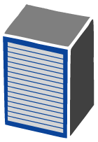

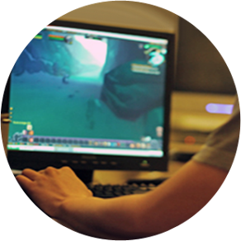
Components of the Criminal Cloud
SPAM BOTNET
Payment Processors
Drive-By
Secondary Malware
Controller
Proxy
Mule Operations
Avalanche: SPAM Cloud that you can lease time
Zeus: IPv6 Compliant “Build your Own Criminal Cloud.
BlackHole: Metasploit Cloud you can lease
Name Servers
BOT
Herder
Malware
Victim of Crime
TLD Domain
Packer

Slide 8
Why not use a IPv6 Criminal Cloud?
SPAM BOTNET
Payment Processors
Drive-By
Secondary Malware
Controller
Proxy
Most Security tools do not detect IPv6.
Firewalls, IPSs, Anti-SPAM, and the whole toolkit we use to manage and run networks are built on IPv4 – no IPv6.
IPv6 is a way for criminals to go under the radar – cause the “radar is IPv4”
Mule Operations
Name Servers
BOT
Herder
Malware
Victim of Crime
TLD Domain
Packer

Slide 9
Stage Domain Name
SPAM BOTNET
Drive-By
Secondary Malware
Controller
Proxy
Get Domain
Name Servers
IPv4 or IPv6
BOT
Herder
Stage on NS or FF NS
Malware
Victim of Crime
TLD Domain
Packer

Slide 10



Prepare Drive-By
Send Malware
SPAM BOTNET
Drive-By
Secondary
Malware
Controller
Proxy
IPv6
Load Malware
Name Servers
IPv6
Hacker
Malware
Victim of Crime
TLD Domain
Packer

Slide 11
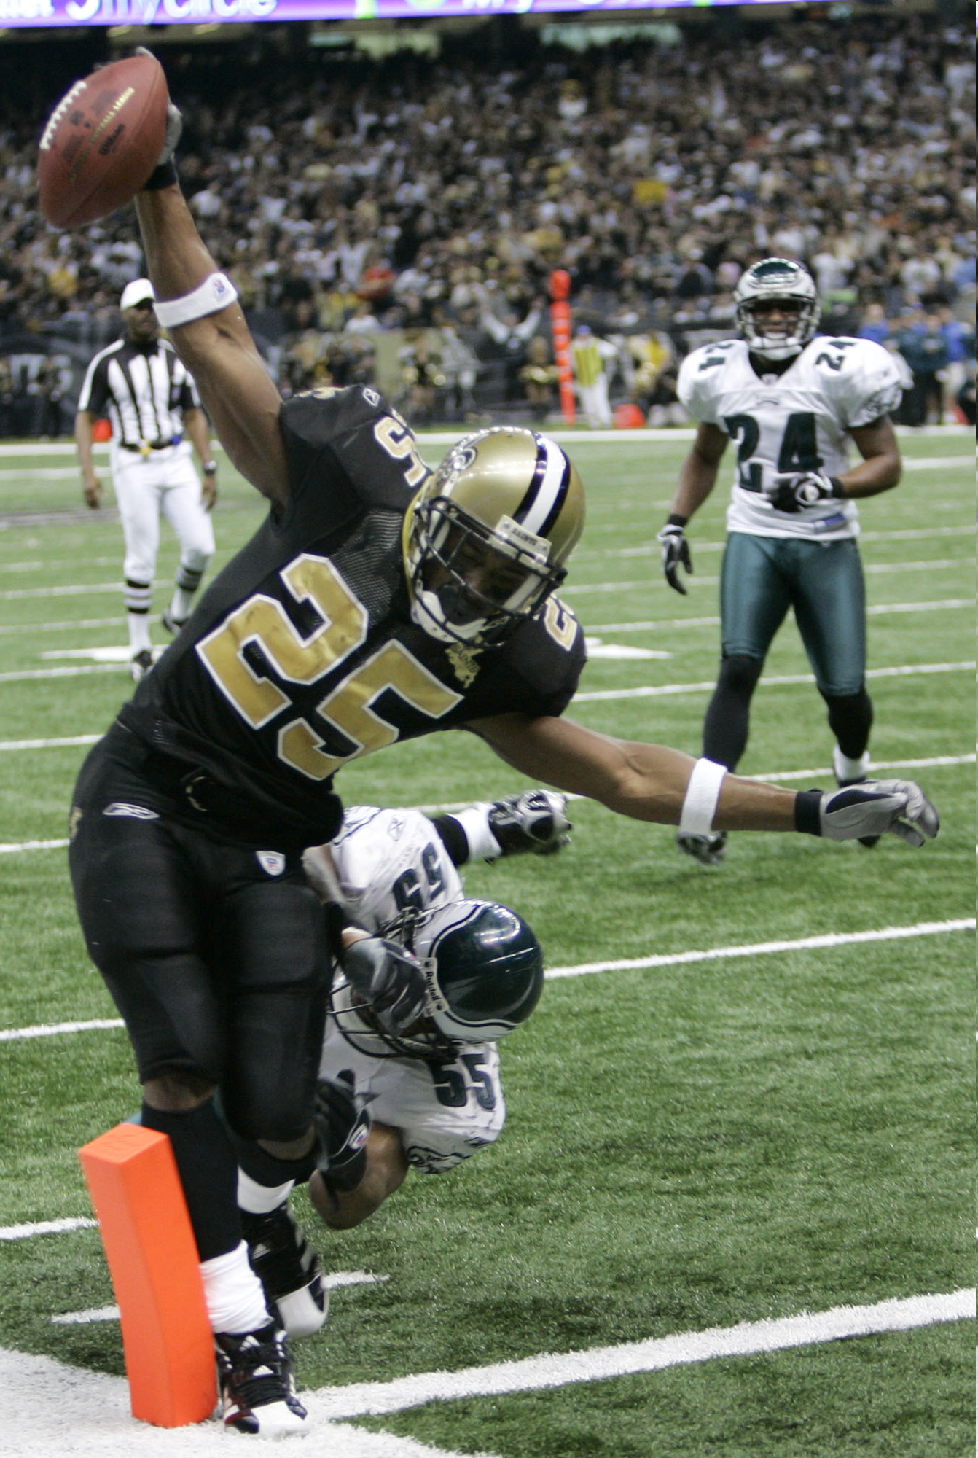
Social Engineered SPAM to Get People to Click
(Spear Phishing)
Send SPAM
SPAM BOTNET
Drive-By
Secondary
Malware
Controller
Proxy
IPv6
Name Servers
Click on me now
Hacker
Malware
Victim of Crime
TLD Domain
Packer

Slide 12







Drive-By Violation
Click on me now
SPAM BOTNET
Drive-By
Secondary
Malware
Controller
Proxy
What if Malvertisment was IPv6?
Name Servers
Hacker
Malware
Victim of Crime
TLD Domain
Packer

Slide 13
Poison Anti-Virus Updates
SPAM BOTNET
Drive-By
Secondary
Malware
Controller
Proxy
Name Servers
Poison the
anti-virus updates
All updates to 127.0.0.1
Hacker
Anti-Virus
Vendor
Malware
Victim of Crime
TLD Domain
Packer

Slide 14

Prepare Violated Computer
SPAM BOTNET
Drive-By
Secondary
Malware
Controller
Proxy
What if this all happened via IPv6?
Name Servers
Call to secondary Malware site
Load secondary
package
Hacker
Anti-Virus
Vendor
Malware
Victim of Crime
TLD Domain
Packer

Slide 15
Call Home
SPAM BOTNET
Drive-By
Secondary
Malware
Controller
Proxy
IPv6
Name Servers
Call to Controller
Report:
Operating System
Anti-Virus
Location on the Net
Software
Patch Level
Bandwidth
Capacity of the computer
Hacker
Malware
Victim of Crime
TLD Domain
Packer

Slide 16
Load Custom Malware
SPAM BOTNET
Drive-By
Secondary Malware
Controller
Proxy
IPv6
Name Servers
IPv6
Go get New Module
Hacker
Malware
TLD Domain
Victim of Crime
Packer

Slide 17

Start Worming, Scanning, & Spreading
SPAM BOTNET
Drive-By
Secondary
Malware
Controller
Proxy
Name Servers
BOTNET
Herder
IPv6
Malware
IPv6
Victims of Crime
TLD Domain
Packer

Slide 18
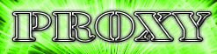
Load a Proxy with Trigger
Corporate Network
Drive-By
Secondary Malware
Controller
Proxy
IPv6
Name Servers
IPv6
Go get my proxy
Hacker
Malware
TLD Domain
Victim of Crime
Packer

Slide 19
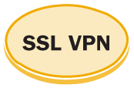
Watch for the SSL VPN Connection
Cool! Lets see what I can find to steal.
Corporate Network
Drive-By
Secondary Malware
Controller
Proxy
Name Servers
IPv6
Hacker
Tell me when the SSL VPN Connection is Established
Malware
TLD Domain
Victim of Crime
Packer

Slide 20
Set up the Proxy Tunnel
Cool! Lets see what I can find to steal.
Corporate Network
Drive-By
Secondary Malware
Controller
Proxy
IPv6
Name Servers
IPv6
Hacker
Malware
TLD Domain
Victim of Crime
Packer

Slide 21
Proxy Behind the Bank Login
Cool! Lets see what I can find to steal.
BANKS
Drive-By
Secondary Malware
Controller
Proxy
IPv6
Name Servers
IPv6
HTTPS
Hacker
Malware
TLD Domain
Victim of Crime
Packer

Slide 22
OPSEC Community’s Action
Make SPAM
Harder
We do not know how to lock this guy in jail!
SPAM BOTNET
Drive-By
Secondary Malware
Controller
Proxy
Disrupt Drive-By Phishing
Disrupt Controllers
Name Servers
Help your victimized customers
BOT
Herder
Disrupt the NS Infrastructure
Clean Violated Data Centers
Malware
TLD Domain
Victim of Crime
Packer
Filter Based on TLD

Slide 23
Scary Consequences (B4 IPv6)
Building “Secure” Operating Systems with “Security Development Lifecycles” and aggressive testing are not delivering to expectations.
Host Security Tools (anti-virus) are not delivering to expectations.
Application Security is not delivering and becoming more complicated.
Network Security tools (firewalls, IDP/IPS, etc) are not delivering as expected.
Defense in Depth are not delivering as expected.
Malware Remediation is not working (i.e. how to clean up infections).
The Bad Guys follow economic equilibrium patterns – finding optimization thresholds.
Law Enforcement is not in a position to act on International Crime – where the laws are not in place.
The “eco-system” of the “security industry” is locked in a symbiotic relationship.

Slide 24

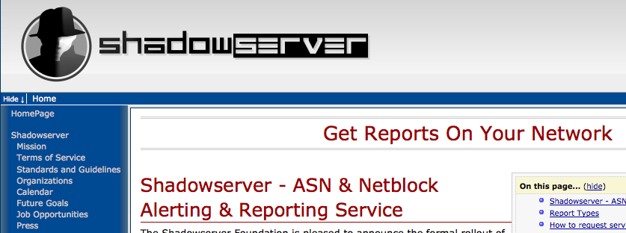
Touch Point
Are you looking for miscreant activities on your network?
If you have IPv6 turned on – are you watching?
Are you looking for v6 in v4 tunnels?
Recommendation – Views from your Network & from the Outside World:
  Free Service from www.shadowserver.org

Slide 25
Understanding Today’s Cyber-Criminal Behavior Drivers

Slide 26
Our Traditional View of the World

Slide 27
The Reality of the Internet
No Borders
How to project civic society and the rule of law
where there is no way to enforce the law?

Slide 28
The Good Guys are part of the the Security Problem
The “White Hat” Security Community fixates on the mechanics – rushing to blog details of how the malware works and how the botnet is built.
It is like the US Drug Enforcement Agency approaching the Meth epidemic with this approach:
  We’re trying to solve the methamphetamine drug abuse problem by funding studies and pontificating on the chemical make up of methamphetamine, processes for producing methamphetamine, and variations for new methamphetamine mixes.
What about the Meth criminal eco-system? What about the gangs? What about the victims?

Slide 29
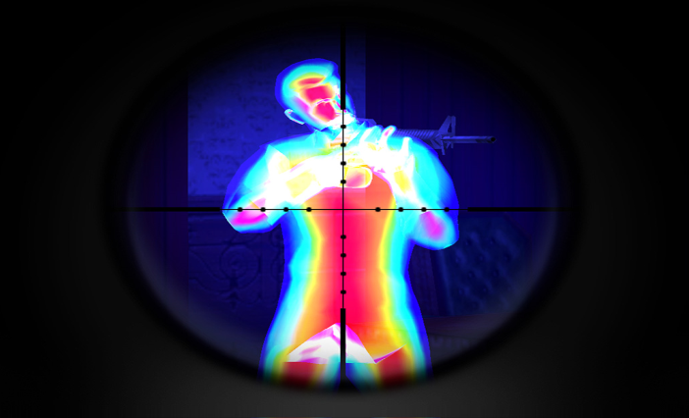

The Good Guys are part of the the Security Problem
Who we need to Target
This is nice to know
Not understanding that our problem is a human problem leads to “security solutions” which get bought, deployed, and never used.

Slide 30
Three Major Threat Vectors
Critical Infrastructure has three major
threat drivers:
  Community #1 Criminal Threat
    Criminal who use critical infrastructure as a tools to commit crime. Their motivation is money.
  Community #2 War Fighting, Espionage and
  Terrorist Threat
    What most people think of when talking about threats to critical infrastructure.
  Community #3 P3 (Patriotic, Passion, &
  Principle) Threat
    Larges group of people motivated by cause – be it national pride (i.e. Estonia & China) or a passion (i.e. Globalization is Wrong)

Slide 31
Essential Criminal Principles
There are key essential principles to a successful miscreant (i.e. cyber criminal)
These principles need to be understood by all Security Professionals
Understanding allows one to cut to the core concerns during security incidents
Attacking the dynamics behind these principles are the core ways we have to attempt a
disruption of the Miscreant Economy

Slide 32
Principles of Successful Cybercriminals
Don’t Get Caught
Don’t work too hard
Follow the money
If you cannot take out the target, move the attack to a coupled dependency of the target
Always build cross jurisdictional attack vectors
Attack people who will not prosecute
Stay below the pain threshold

Slide 33
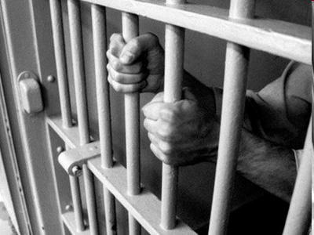
Principle 1: Do Not Get Caught!
The first principle is the most important – it is
no fun getting caught, prosecuted, and thrown
in jail
  (or in organized crime – getting killed)
All threat vectors used by a miscreant will have an element of un-traceability to the source
If a criminate activity can be traced, it is one of three things:
  A violated computer/network resources used
  by the miscreant
  A distraction to the real action
  A really dumb newbie

Slide 34
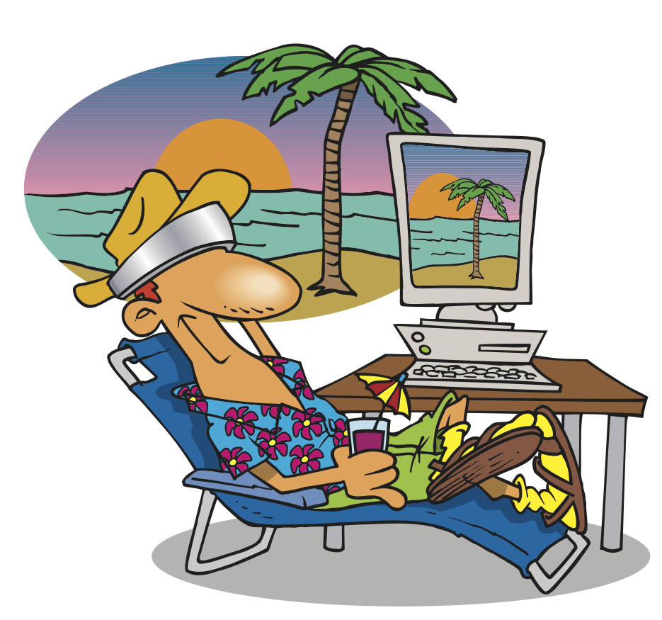
Principle 2: Do Not Work Too Hard!
Use the easiest attack/penetration vector
available in the toolkit to achieve the
job’s objective
Example: If your job is to take out a company’s Internet access the day of the quarterly
number’s announcement, would you:
  Penetrate the Site and Delete files?
  Build a custom worm to create havoc in the company?
  DOS the Internet connection?
  DOS the SP supporting the connection?
Why Use DNS “Noisy” Poisoning when it is easier to violate a ccTLD?

Slide 35
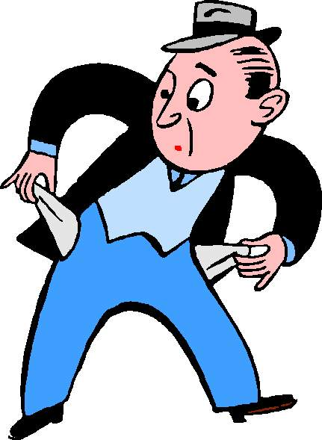

Principle 3: Follow the Money
If there is no money in the crime then it is not worth the effort.
Follow the money is the flow of money or exchanged value as one miscreant transfers value to another miscreant (or the victim transfers value to the criminal)
A Cyber-Criminal Threat Vector opens when the miscreant finds a way to move ‘stored value’ from the victim through the economy
It is worse if the cyber ‘stored value’ can cross over to normal economic exchange

Slide 36
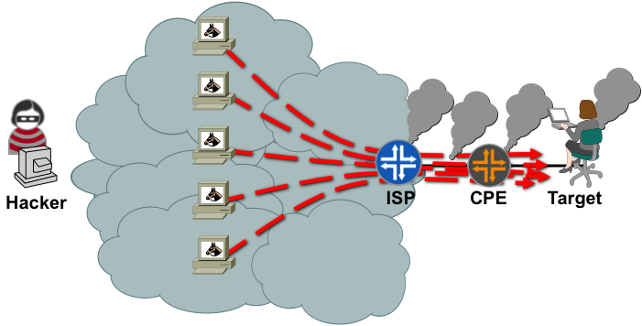
Principle 4: If You Cannot Take Out The Target…
If you cannot take out the target, move the
attack to a coupled dependency of the target
There are lots of coupled dependencies in
a system:
  The target’s supporting PE router
  Control Plane
  DNS Servers
  State Devices (Firewalls, IPS, Load Balancers)
Collateral Damage!

Slide 37
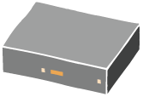


Principle 5: Always Build Cross Jurisdictional Attack Vectors
Remember – Don’t get caught! Do make sure
ever thing you do is cross jurisdictional.
Even better – cross the
law systems (Constitutional, Tort, Statutory, Islamic, etc.)
Even Better – Make sure your “gang” is multi-national – making it harder for Law Enforcement
BOTNET LEAF
US
BOTNET
HUB
BOTNET LEAF
Japan
BOTNET LEAF
Australia
BOTNET LEAF
Norway
BOTNET LEAF
Kuwait
BOTNET LEAF
China

Slide 38
Principle 6: Attack People Who
Will NOT Prosecute
If your activity is something that would not want everyone around you to know about, then you are a miscreant target
Why? Cause when you become a victim, you are not motivated to call the authorities
Examples:
  Someone addicted to gambling is targeted via a Phishing site
  Someone addicted to porn is targeted to get botted
  Someone addicted to chat is targeted to get botted
  Someone new to the Net is targeted and abused on the
  physical world
  Government, Finance, and Defense, Employees – who lose
  face when they have to call INFOSEC

Slide 39
Principle 7: Stay below the Pain Threshold
The Pain Threshold is the point where an SP or
Law Enforcement would pay attention
If you are below the pain threshold – where you
do not impact an SP’s business, then the SP’s Executive Management do not care to act
If you are below the pain threshold – where you do not have a lot of people calling the police, then the Law Enforcement and Elected Official do not care to act
The Pain Threshold is a matter of QOS, Resource Management, and picking targets which will not trigger action

Slide 40

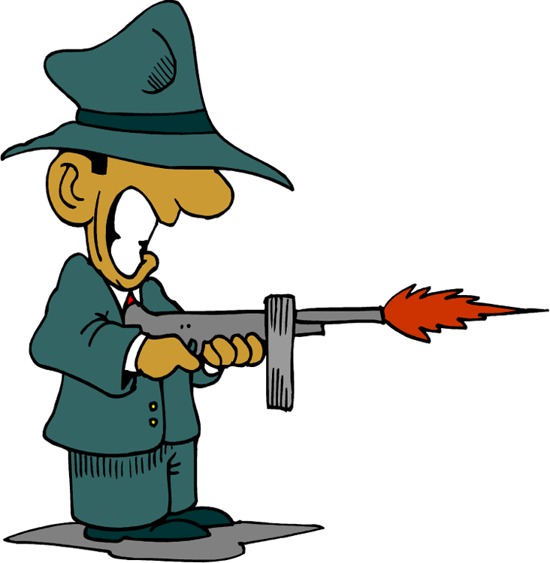
Criminal Trust
Miscreants will guardedly trust each other
They can be competitors
They can be collaborators
But when there is money on the table, criminal human behavior and greed take over.
Cybercriminal cannibalize each other’s infrastructure.
Cybercriminals attack each other’s infrastructure.
DDOS
Internet
DDOS

Slide 41
Dire Consequences
The Miscreant Economy is not a joke. It is not
a game. It is not something to play with.
  PEOPLE DIE
Once organized crime enter the world of the Miscreant Economy, the days of fun were over.
Now that Cyber-Criminals will use any resource on the net to commit their crime, they don’t worry about the collateral damage done.
  Think of computer resources at a hospital, power plant, or oil refinery – infected and used to commit phishing and card jacking.
  What happens if someone gets mad at the phishing site, attacks it in retaliation, unintentionally knocking out a key systems.

Slide 42
Enduring Financial Opportunities
Postulate: Strong, Enduring Criminal Financial Opportunities Will Motivate Participants in the Threat Economy to Innovate to Overcome New Technology Barriers Placed in Their Way
Enduring criminal financial opportunities:
Extortion
Advertising
Fraudulent sales
Identity theft and financial fraud
Theft of goods/services
Espionage/theft of information

Slide 43
Threat Economy: In the Past
Writers
Asset
End Value
Tool and Toolkit Writers
Compromise Individual Host or Application
Fame
Theft
Malware Writers
Worms
Espionage
(Corporate/ Government)
Compromise Environment
Viruses
Trojans

Slide 44
Threat Economy: Today
Writers
First Stage Abusers
Middle Men
Second Stage Abusers
End Value
Tool and Toolkit Writers
Hacker/Direct Attack
Criminal Competition
Compromised Host and Application
Theft
Malware Writers
Espionage
(Corporate/ Government)
Machine Harvesting
Extortionist/ DDoS-for-Hire
Worms
Bot-Net Creation
Extorted Pay-Offs
Viruses
Bot-Net Management:
For Rent, for Lease, for Sale
Spammer
Commercial Sales
Trojans
Phisher
Information Harvesting
Personal Information
Fraudulent Sales
Spyware
Pharmer/DNS Poisoning
Click-Through Revenue
Information Brokerage
Internal Theft: Abuse of Privilege
Identity Theft
Financial Fraud
Electronic IP Leakage
$$$ Flow of Money $$$

Slide 45

Miscreant - Incident Economic Cycles
Peak
Lots of Problems
& Attacks
Community
Mitigation
Survive the Next Attack
New Criminal Revenue Opportunities
Miscreant & Criminal
R&D
Incidents
Resolve the Problem
Recession
Expansion
Drive the Post Mortem
Drive the Preparation
Trough
time
These Cycles Repeat
Notes:
12

Slide 46
Miscreant Economic Cycles
Expansion
Recession
Expansion
Boom
Peak
Upturn
Downturn
Total Incidents
Incident Growth Trend
Trough
0
Jan.-
Mar
Apr.-
June
July-
Sept.
Oct.-
Dec.
Jan.-
Mar
Apr.-
June
July-
Sept.
Oct.-
Dec.
Jan.-
Mar
Apr.-
June

Slide 47
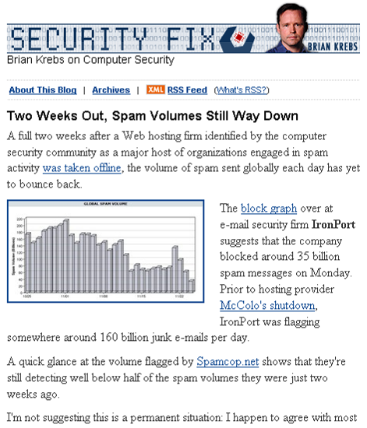
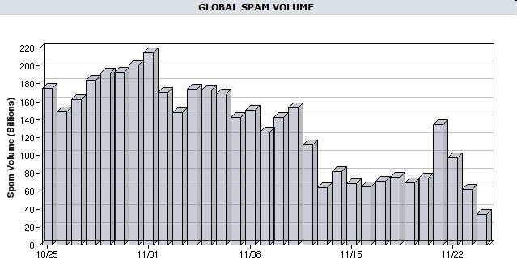
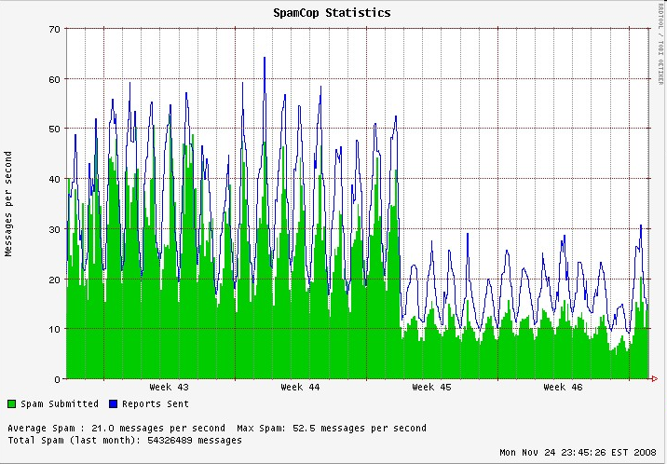
Community Action Can Have an Impact
Source: http://voices.washingtonpost.com/securityfix/2008/11/64_69_65_73_70_61_6d_64_69_65.html

Slide 48
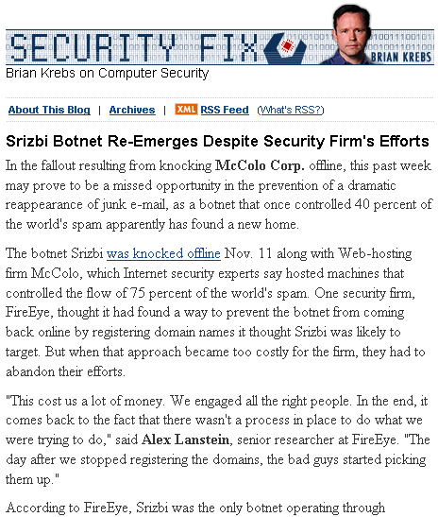
But for how long …..
New Attack
Tools
& Techniques
Good
Guys
Whack
Bad Guys
Learn
Back Guys
Analyze
This virtuous cycle drives cyber-criminal IPv6 innovations.

Slide 49
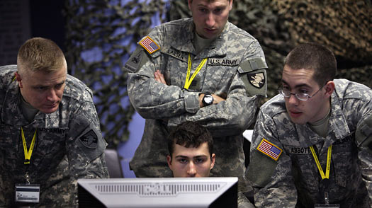
Cyber Warfare
Of the three threat vectors, cyber-warfare is a “constrained” threat.
All cyber warfare is a constrained with in State Actors and Actions.
  There are Generals who are in charge giving orders.
  There are Government officials who are providing state policy.
Espionage is part of state policy, a persistent threat, but not “warfare.”
New State actors can make mistakes – unintentionally creating collateral consequence.
Michael Falco / The New York Times / Redux

Slide 50
Cyber Warfare’s Consequences …
Peer A
IXP-W
A
Peer B
IXP-E
Upstream A
D
Upstream A
B
C
Upstream B
Upstream B
E
Target
G
NOC
F
POP
Target is taken out

Slide 51
… Extend beyond the perceived “Battle Space.”
Peer A
IXP-W
A
Peer B
IXP-E
Upstream A
D
Upstream A
B
C
Upstream B
Upstream B
E
Target
Customers
Attack causes Collateral Damage
G
NOC
F
POP

Slide 52
Cyber Warfare’s Reality
Cyber Warfare is a threat to business, but not the threat to spend hours and money to protect.
Protecting against Cyber-Crime and the P3 threat will mitigate many of the cyber warfare threats.

Slide 53

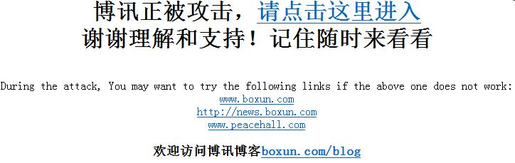
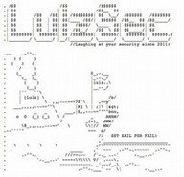
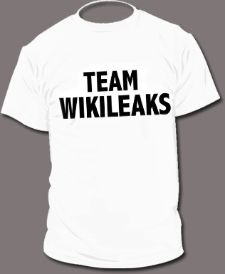


P3 Threat – the Big Change
The Dramatic Change over the past year has been the increasing security threat from individuals and groups that are not “constrained.”
These groups are driven by motivations that are not “money driven.” They are not given “orders.” They do it based on self motivation.
Patriotic – They believe they have a right to stand up for their country, cause, or crusade.
Passionate – They attach to a cause and will work long hours to further that cause.
“Principled” – The base their actions on principles they passionately believe and will perform actions that they feel is within their “Internet Rights.”

Slide 54

Patriotic, Passion, & Principle Drivers
“The post-90 generation teens that run 2009.90admin. com, wrote on their website, “We are not Internet attackers, we are just a group of computer fans; we are not mentally handicapped kids, we are the real patriotic youth. We’ll target anti-China websites across the nation and send it as a birthday gift to our country.”
“The 500-word statement appeared over a red and black background decorated with a flying national flag. Zhang Yiwu, a professor at Peking University and a literary critic, said although many believe young people are not as patriotic as previous generations, there are exceptions.
"The post-90s generation is undoubtedly passionate and patriotic, but their lifestyle and attitude is varied. The campaign of attacking anti-China websites shows their unstable and immature nature," Zhang said. "Although their behavior is not worthy of praise, the unfair reports about China coming from many foreign media will encourage the youngsters to fight back.“”
- http://news.alibaba.com/article/detail/technology/100168523-1-teen-hackers-vow-prove-patriotism.html

Slide 55
Touch Point
Do you use “behavior” as a tool to help you evaluate risk?

Slide 56
Now What?

Slide 57
What can you do?
This security problem is happening now – with IPv4. Gain control over it now.
  Use the IPv4 knowledge to map what you really need for dual stack.
  Use Open Source Security tools (Bothunter, Netflow Tools, IDP/IDS tools, etc). Open source gives you experience before the big capital investment.
Understand that you might have a IPv6 “security problems” right now.
  Security people inside a organization need to be pushing for strategic IPv6 deployment to gain situational awareness of the IPv6 in their network.

Slide 58
What can you do?
An IPv6 VISIBILITY plan is needed as part of your IPv6 deployment.
  Given the criminal economic incentives behind the threat, all organizations need to have visibility tools as an integral part of their IPv6 plan.
  Passive DNS, Open Source Netflow, IPv6 Sinkholes, Network management, logging (compatible with IPv6).
Yes, you will need a IPv6 Security Plan.
  Know how you security team is going to cope with IPv6.

Slide 59
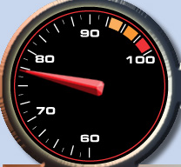
No Excuses!
An organization cannot use the dynamics & threat of the cyber criminal ecosystem to not deploy IPv6.
The pace if IPv6 migration is not in the control of the end-user. Moving from “zero” to “100” is a crowd dynamic.
That “crowd” can move the industry faster than anyone expects.
The criminals will follow the crowd – following their potential markets.

Slide 60
Plug into the Operational Security Community
Step 1: Get the Operational and Security Contacts for each of your peering and transit networks.
  Get their phone numbers, Chat IDs, and E-mails.
  Find out what tools they have deployed to help you “work an attack” and “work a criminal investigation.”
  Find out what other civic self-defense groups they belong to.
Step 2: Join open “security communities” which allow you to work with others to defend each other.
  CERTs
  ISACs
  Others.
Step 3: Act! Do Something! Fight Back!
  Investigate – pursue – take legal action
  Call Law Enforcement – pull in the police – file a case
  International Laws only change through action

Slide 61
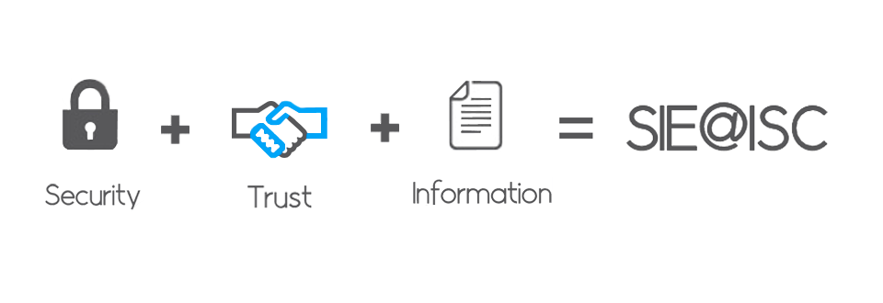
What can you do?
Join the Security Information Exchange Forum (SIE@ISC).
  Forum only briefings on the threat and tools used to change the battle against the threat.
  Connect you and your organizations to the most appropriate operational security communities – building the sphere of trust with peers
  Funding the tools the Operational Security Community need to track the threats, disrupt the threat, and put the community into a position to arrest the threat.
  Gain insight into how “collective defense” protects everyone. everyone.
Send E-mail to info@sie.isc.org

Slide 62
Summary and Questions

Slide 63
Internet Systems Consortium (ISC)
How we can help your IPv6 Journey

Slide 64

Who Builds the Cogs?
The Internet’s “Guts” require someone to build the cogs which keep the Internet moving.
These “cogs” need to be open and accessible to anyone who wants to connect to the Internet.
Standards need to be open so that anyone can build.
Enter the Internet Systems Consortium (ISC)

Slide 65
Technology Leadership for the Common Good
DIALOGUE
IETF
REFERENCEABLE CODE
OPEN SOURCE CODE DEVELOPMENT
OPERATIONAL
CODE
FREE OPEN SOURCE PRODUCTION QUALITY SOFTWARE
OTHER COMMERCIAL PLAYERS BENEFIT
Infoblox
Bluecat, etc
ISC FORUM
ISC SUPPORT SERVICES
Agile and scrum
Regression testing
Community input
E.G BIND, DHCP, AFTR,SIE

Slide 66
More “Common Good” Activities
DNS Everywhere
IPv6
DNSSEC
OPS-SEC
Secondary DNS Services
DNS F-Root
Hosted @ w/ Open Source Community and Others
Security Data Peering

Slide 67
Sustainability while Serving Community
Professional Services
  Software Support
  Training
  Consulting
Custom Software Development
  Usability features
  Operation Improvements
  Private branches
  Proto types
  Integration/APIs

Slide 68

New from ISC

Slide 69


ISC In a Nutshell
Forum
Professional Services
Public Benefit Services
BIND
BIND 10 Working Group
DHCP
AFTR/PCP
SIE
Open Source Routing
RPKI (Securing BGP) and more to come … first reference, standards based code.
Consulting
Training
Software Support Services
Custom Software Development
F-root Corporate Node
DNS SNS-Com
Full version The Domain Survey
DNS “F-ROOT”
DNS Secondary Server Resiliency (SNS) PB
Hosted@ - hosting a range of open source code)
Free Domain Survey Report
ISC assistance at IETF, ICANN, ARIN, ISOC RIPE WG, UKNOF, etc
Empowerment
Standards drivers – with first implementation of standards based code.
Policy Meetings – Empowering Spheres of Influence
Operational Security – Pioneering new approaches to safe guard the Internet (OPSEC-Trust).
Operations Meeting Empowerment (APRICOT, AFNOG, NANOG, etc)
Research (DNS OARC)

Slide 70
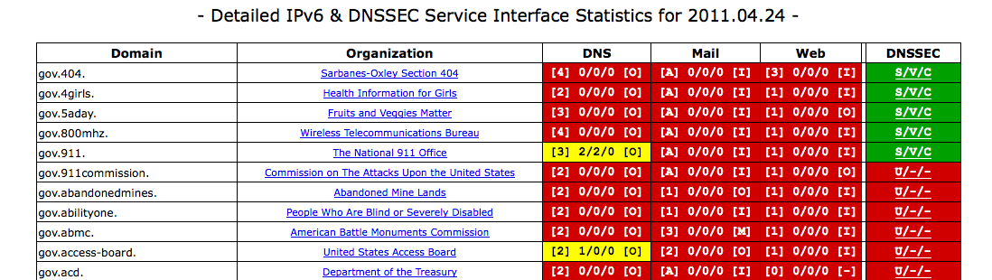
How can ISC Help?
(Keeping it Simple)
Check your Ipv6 Health @ http://usgv6-deploymon.antd.nist.gov/
If your DNS or DNSSEC is RED (i.e. not IPv6 dual stack), contact ISC for help. Everyone needs to be GREEN.
Send an E-mail to info@isc.org to start the conversation.

